Slide 1
Applied Computer Graphics and Vision
Lecture 04: Modelling and Drawing

Slide 2
Overview
WebGL primitives
Surface normal and vertex winding order
Drawing methods
  gl.drawArrays()
  gl.drawElements()

Slide 3
WebGL Primitives
You can use WebGL to create complex 3D models. However, these 3D models all have to be built up using the following three basic geometric primitives:
  Triangles – for defining surfaces.
  Lines – for drawing wireframes.
  Point sprites – for create discrete particles (e.g., clouds, gas, etc).

Slide 4

Triangles
Most 3D graphics hardware is highly optimized for drawing triangles.
Triangles are seldom used as single, separate entities. Many triangles are connected for form polygon meshes to define surfaces.

Slide 5
Triangle Primitives
Triangles, according to the way they are organised/connected, can form different geometric objects.
WebGL provides three different triangle primitives:
  gl.TRIANGLES,
  gl.TRIANGLE_STRIP, and
  gl.TRIANGLE_FAN.
We will study the primitives in detail, but we first look at the properties of a single triangle.

Slide 6
Single Triangles
A triangle is defined by three vertices (points).
In other subjects, such as in geometry, we usually don’t care about the order of the vertices. Given 3 vertices, the triangle is fully defined.
But in CG, the order we list the vertices (called winding order) are important: it defines the surface normal of the triangle.
V₁
V₂
V₃

Slide 7
Surface Normals
In CG, a surface has two sides: inside and outside. A surface is only visible when we see it from outside. Seeing from inside, a surface is transparent.
The outside (visible side) of a surface is indicated by its normal – a unit vector that is orthogonal to the surface where it adheres to and points away from the surface.
Unit vector
Right angles

Slide 8
Vectors
A vector is a geometric entity that has a direction and length.
In math form, a vector is written as a column matrix:
or
where v_{x}, v_{y} and v_{z} are the components (projections) of the vector along each coordinate axes.
Its length is calculated as
z
v_{z}
V
v_{y}
v_{x}
y
x

Slide 9
Unit Vector
When using a vector to represent a direction, its size does not matter. In such cases, a unit vector is used.
A unit vector is a vector that has unit length, i.e.,
We normally denote a unit vector with bold case letter n and its components by n_{x}, n_{y} and n_{z}, i.e.,
and

Slide 10
Vector Normalisation
A non-unit vector can be normalised to make it a unit one
A general vector V can be normalised by dividing its components by its length:

Slide 11
Dot Product of Vectors
The dot product of two vectors,v₁ and v₂ are defined as
We can tell the range of the angles between two vectors by their dot product:
  if their dot product is 0, then the angle between them is 90 degrees,
  if the dot product is greater than 0, then the angle between them is less than 90 degrees,
  if the dot product is less than 0, then the angle between them is greater than 90 degrees.
V₁
V₁
V₁
V₂
V₂
V₂
θ<90, cosθ>0
θ=90, cosθ=0
θ>90, cosθ<0

Slide 12
Calculation of Components of a Unit Vector
A unit vector’s components equal the dot products of the vector and the unit vectors representing the direction of the coordinate axes, i.e.,
where α, β and γ are the angles between the vector and coordinate axes.
This is because the dot product of two unit vectors equals
1x1xcosα=cosα
n
z
γ
y
β
α
x

Slide 13
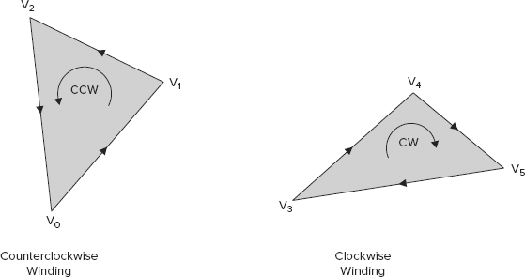
Vertex Wind Order & Surface Normal
The winding could be clockwise (CW) and counter-clockwise (CCW)

Slide 14
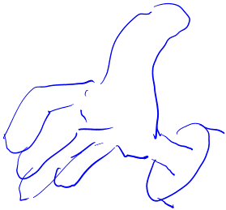
CCW or CW
CCW defines front-facing triangles, while CW defines triangles that are back-facing.
This facing convention can be remember using the right-hand rule - pointing the thumb at the direction of the surface normal, then the direction of the other fingers indicates the order of winding
V
V
V₁
V₂
V₃

Slide 15
Specifying Normals
Consider the triangle defined by vertices V1, V2, V3:
By the convention, (V1, V2, V3), (V2, V3, V1) or (V3, V1, V2) define the same triangle. But (V1, V3, V2), (V3, V2, V1), or (V2, V1, V3) define a different triangle – the difference is in their facing direction (i.e., visibility).
V₁
V₂
V₃

Slide 16
Uses of Normals
If the normal of a triangle points to the direction of viewer, the triangle is visible. We call the triangle is front-facing.
If the normal points to the opposite side, the triangle is invisible and we call the triangle is back-facing.
We normally do not rasterize triangles that are back-facing.
This operation of removing such triangles is called back-surface culling.

Slide 17
Cont’d
Back facing triangles can be found by calculating the dot product of the surface normal, n, and the vector representing the viewer’s direction, V_{view} .
I.e., if n.V_{view}>0, the triangle is back-facing.
n
V_{view} viewing direction/vector

Slide 18
Cont’d
Surface normal is also used in calculating the shade of a fragment/pixel
The shade of a fragment is determined by calculating the amount of light reflected from that fragment – the operation is called shading (more on this topic in later lectures).
How much light is reflected from this point? Or how bright/dark is the point when you see it from there?
It depends on many things: the direction of incidence (incident angle), surface material, where you see it,…

Slide 19
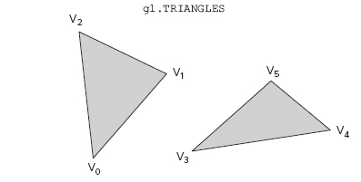
gl.TRIANGLES
  In WebGL, independent/individual triangles are of the primitive type gl.TRIANGLES.
  If you use gl.drawArrays()to draw triangles (we have other ways to draw triangles), you must specify three vertices for each triangle, and if you want to draw several triangles, they are drawn separately (i.e., vertices from one triangle are not automatically re-used in another triangle).

Slide 20
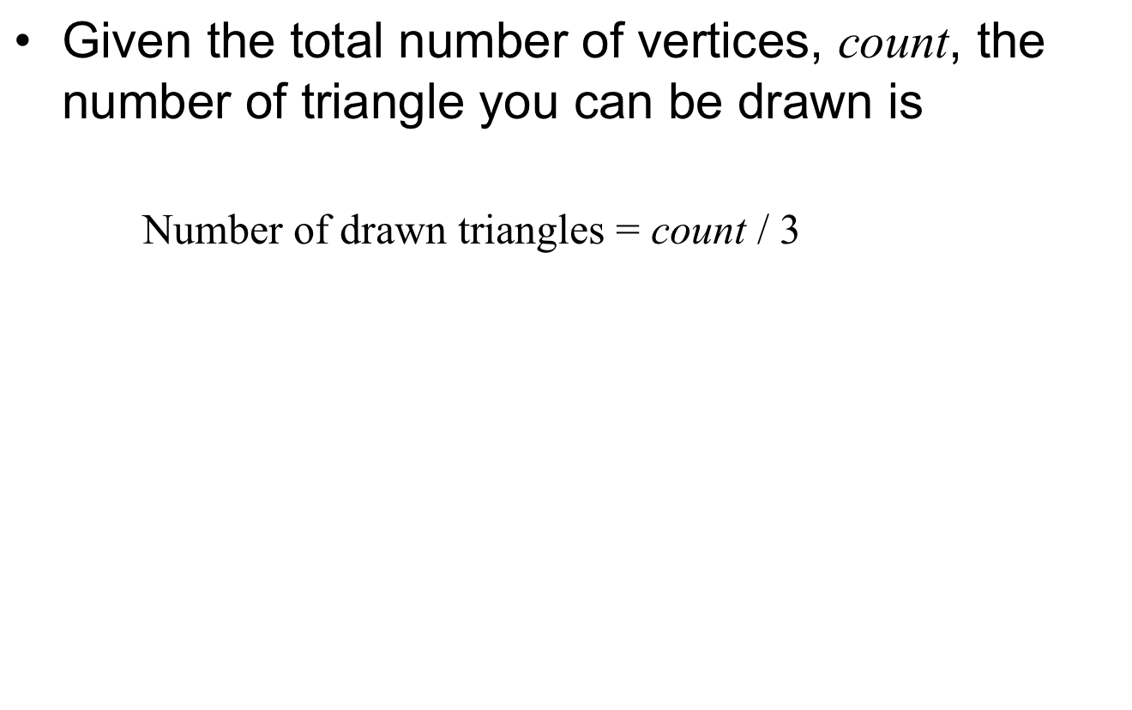
Cont’d

Slide 21
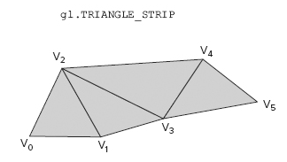
gl.TRIANGLE_STRIP
For many geometric objects, it is more efficient to draw connected triangles.
The primitive, gl.TRIANGLE_STRIP, has been designed for such use. A triangle strip reuses vertices between the triangles.
This allows you to specify fewer vertices when building up the triangles for your geometric models.
Fewer vertices mean less data to store, and also means less data to transfer from the memory to the GPU.

Slide 22
Drawing TRIANGLE_STRIP
For the above triangle strip, the drawing procedure is as the following:
  the first triangle in the strip is drawn from vertices (V0, V1, V2).
  the second triangle is drawn from (V2, V1, V3).
  the third triangle is from (V2, V3, V4), and
  the fourth triangle is from (V4, V3, V5).
We can see that, except for the first triangle, other triangles are created by adding a new vertex each time.

Slide 23
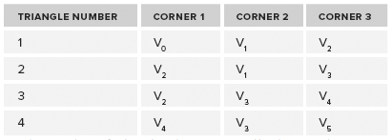
Cont’d
Put the vertex in a table we notice that for each pair of triangle, the last two vertices are reused in the second triangle and their order is reversed in the second triangle
Note: the the order of the first two vertices are reversed in these two rows

Slide 24
Cont’d
The drawing pattern shown in this example is followed for all triangle strips. After the first triangle, each new vertex, together with two vertices from the last triangle, creates a new triangle.
Note: the vertices for the first triangle were specified in ccw order, this order must be followed for the other triangle in the strip.

Slide 25
Data Efficiency
The number of triangles that are actually drawn when you use gl.TRIANGLE_STRIP and gl.drawArrays() will be
      Number of drawn triangles = count − 2
where count is the total number of vertices.
This gives a great improvement in data efficiency in comparison with count/3 of the primitive gl.TRIANGLES when the value of count is big.

Slide 26
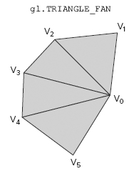
gl.TRIANGLE_FAN
A triangle fan shares a common vertex (V₀), called origin.
For a triangle fan, the first three vertices create the first triangle. The first vertex is also used as the origin for the fan, and after the first triangle every other vertex that is specified forms a new triangle with the previous vertex and the origin.
E.g., (V0, V1, V2) creates the first triangle, (V0, V2, V3) creates the second, (V0, V3, V4) the third, and (V0, V4, V5) the forth.
The number of triangles that are drawn is also
      Number of drawn triangles = count − 2

Slide 27
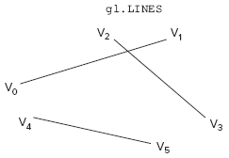
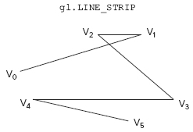
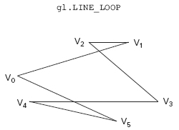
WebGL Lines
gl.LINES are separate lines, e.g., lines between (V0, V1), (V2, V3), and (V4, V5)
    Number of drawn lines = vertex count/2
gl.LINE_STRIP is a linked line, e.g., a line linked between (V0, V1), (V1, V2), (V2, V3), (V3, V4), and (V4, V5).
    Number of drawn lines = vertex count-1
gl.LINE_LOOP dis line loop, e.g., loop formed with lines (V0, V1), (V1, V2), (V2, V3), (V3, V4), (V4, V5), and (V5, V0).
    Number of drawn lines = vertex count

Slide 28
Point Sprites
The last primitive in WebGL is the point sprite, gl.POINTS.
One point is rendered for each coordinate in the vertex array.
When using a point sprite, one should also set the size of the point sprite in the vertex shader. This is done by writing the size in pixels to the built-in special variable gl_PointSize.
E.g.,
  <script id=”shader-vs” type=”x-shader/x-vertex”>
  attribute vec3 aVertexPos;
  void main() {
  gl_Position = vec4(aVertexPos, 1.0); //GLSL built-in //variable
  gl_PointSize = 5.0; ; //GLSL built-in variable
  }
  </script>

Slide 29
Drawing Methods
In WebGL, there are three methods for updating the drawing buffer:
  gl.drawArrays()
  gl.drawElements()
  gl.clear()
The first two methods are for drawing the primitives.
Method gl.clear() is used to refresh the drawing buffer. It sets all the pixels to the colour that has been previously specified using the method gl.clearColor().

Slide 30
gl.drawArrays()
The prototype for gl.drawArrays() is as follows:
void drawArrays(GLenum mode, GLint first, GLsizei count)
  mode specifies which primitives should be drawn. It could be: gl.POINTS, gl.LINES, gl.LINE_LOOP, gl.LINE_STRIP, gl.TRIANGLES, gl.TRIANGLE_STRIP, or gl.TRIANGLE_FAN
  first specifies index (position) of the first data item in the array of vertex data that should be used as the first data entry.
  count specifies how many vertices should be used.
The function constructs a sequence of geometric primitives by successively transferring elements first through first+count-1 of each enabled array to the specified primitive.

Slide 31
Cont’d
gl.drawArrays() draws the primitives using the vertex data in the correct order in the enabled WebGLBuffer objects that are bound to the gl.ARRAY_BUFFER target.
This means that before you can call gl.drawArrrays(), you must do the following:
  Create a WebGLBuffer object with gl.createBuffer().
  Bind the WebGLBuffer object to the correct type, gl.ARRAY_BUFFER, using gl.bindBuffer().
  Load vertex data into the buffer using gl.bufferData().
  Enable the generic vertex attribute array using gl.enableVertexAttribArray().
  Connect the correct data in the WebGLBuffer object with the attribute (e.g., the variable for vertex coordinates) in the vertex shader with by calling gl.vertexAttribPointer().

Slide 32
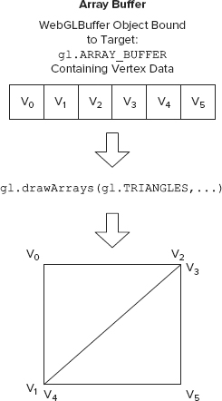
WebGL
Array Buffer
note the repeated vertices

Slide 33
Cont’d
The way gl.drawArrays() is designed makes it mandatory to have the vertices for the primitives in correct order.
The method is simple and fast if you don’t have many shared vertices.
However, if you have an object that consists of a mesh of triangles that share a lot of vertices, it is better to use the method gl.drawElements().

Slide 34
gl.drawElements()
The method gl.drawElements() is also referred to as indexed drawing, which means the indices of the vertices are used in drawing.
It is a way to reuse the vertices to save memory and data throughput.
The method gl.drawElements() also uses the array buffers that contain the vertex data.
But in addition, it uses an element array buffer (a WebGLBuffer object that is bound to the gl.ELEMENT_ARRAY_BUFFER target) to store the vertex indices of triangles.

Slide 35
Cont’d
When triangles share vertices, instead of storing the vertex data several copies, several items in the element array buffer point to the same data item in the vertex data buffer (of type gl.ARRAY_BUFFER)
Therefore the vertex data in array buffers can be in any order since it is the indices in the element-array-buffer object that decide the order in which gl.drawElements() uses the vertices.

Slide 36
Function Prototype
The prototype of drawElements() method:
  void drawElements(GLenum mode, GLsizei count, GLenum type, GLintptr offset)
The arguments are:
  mode specifies the primitive you want to draw, the same as for the drawArrays() method.
  count specifies how many indices you have in the buffer bound to the gl.ELEMENT_ARRAY_BUFFER target.
  type specifies the data type for the element indices that are stored in the buffer bound to gl.ELEMENT_ARRAY_BUFFER. It could be
    gl.UNSIGNED_BYTE or
    gl.UNSIGNED_SHORT.
  offset specifies the offset into the buffer bound to gl.ELEMENT_ARRAY_BUFFER where the indices start.

Slide 37
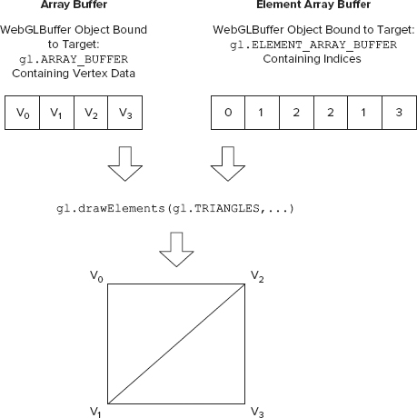

Slide 38
Usage
When you can call gl.drawElements(), you need to set up the array buffers in the same way as for gl.drawArrays().
You also need to set up the element array buffer by doing the following:
  Create a WebGLBuffer object using gl.createBuffer().
  Bind the WebGLBuffer object to the target gl.ELEMENT_ARRAY_BUFFER using gl.bindBuffer().
  Load indices that decide the order in which the vertex data are to be used into the buffer using gl.bufferData().

Slide 39
Further Reading
Anyuru, A., WebGL Programming – Develop 3D Graphics for the Web
  Chapter 3, Section 1

